Slide 1
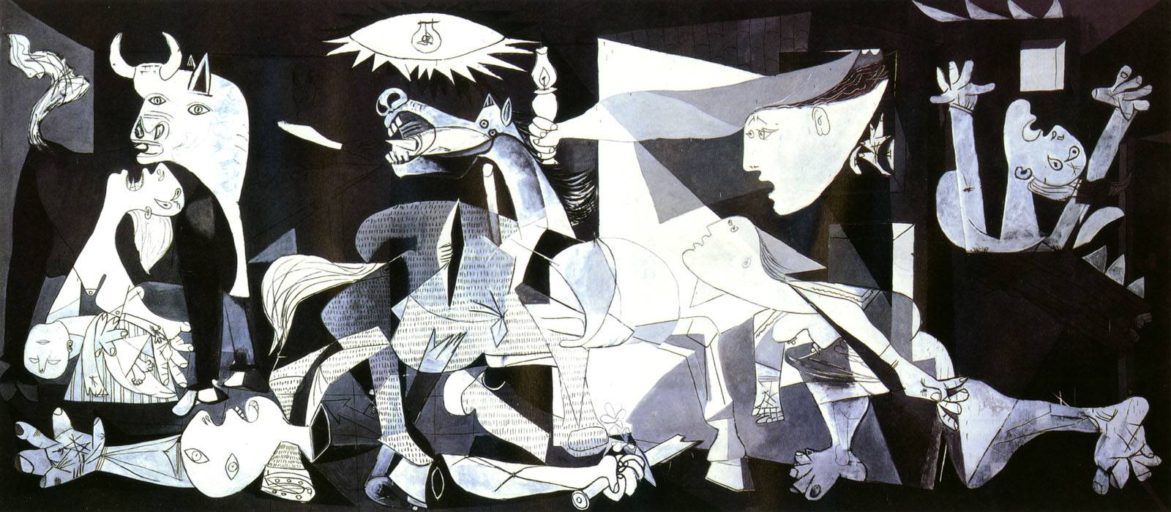
UnlockingArt V0
Guernica, 1937 by Pablo Picasso (Spanish, 1881-1973)
Oil Painting 11’ x 25.6’
Museo Reina Sofía , Madrid, Spain
Cubism

